Slide 1

Indiana’s New Education and Training Pathway is Here.
The Indiana Career Apprenticeship Pathway
is now available at [SCHOOL NAME].
The pathway offers multi-year apprenticeships that begin in high school, combining classroom learning with paid on-the-job education and training. INCAP is designed with Indiana’s new high school graduation requirements in mind, and satisfies the key requirements for earning the Employment Honors Diploma Seal.

Slide 2

Earning the Employment Honors Plus Seal with INCAP.
Here’s how INCAP works for high school students:
INCAP provides a structure for students to earn the Employment Honors Diploma Seal.
INCAP apprenticeships provide at least 650 hours of work-based learning.
INCAP apprenticeships culminate in an INCAP credential or degree, depending upon the apprenticeship. These are included on Indiana’s Credentials of Value list.
INCAP credentials and degrees may count toward college credit.
Many INCAP apprenticeships allow students to pursue the Enrollment Honors Plus
or Enlistment & Service Honors Diploma Plus seals, expanding their options after high school.

Slide 3

What is the INCAP Experience?
INCAP apprenticeships are designed around real workforce needs identified by employers. With INCAP:
Students gain multiple years of paid work experience, learning skills in high-demand industries.
Schedules vary by occupation and grade level.
Most students spend two to four full days each week at their employer and the remaining days at school.
In many cases, participation in sports and other extracurriculars is possible. School counselors help each student build a schedule that works for them.

Slide 4
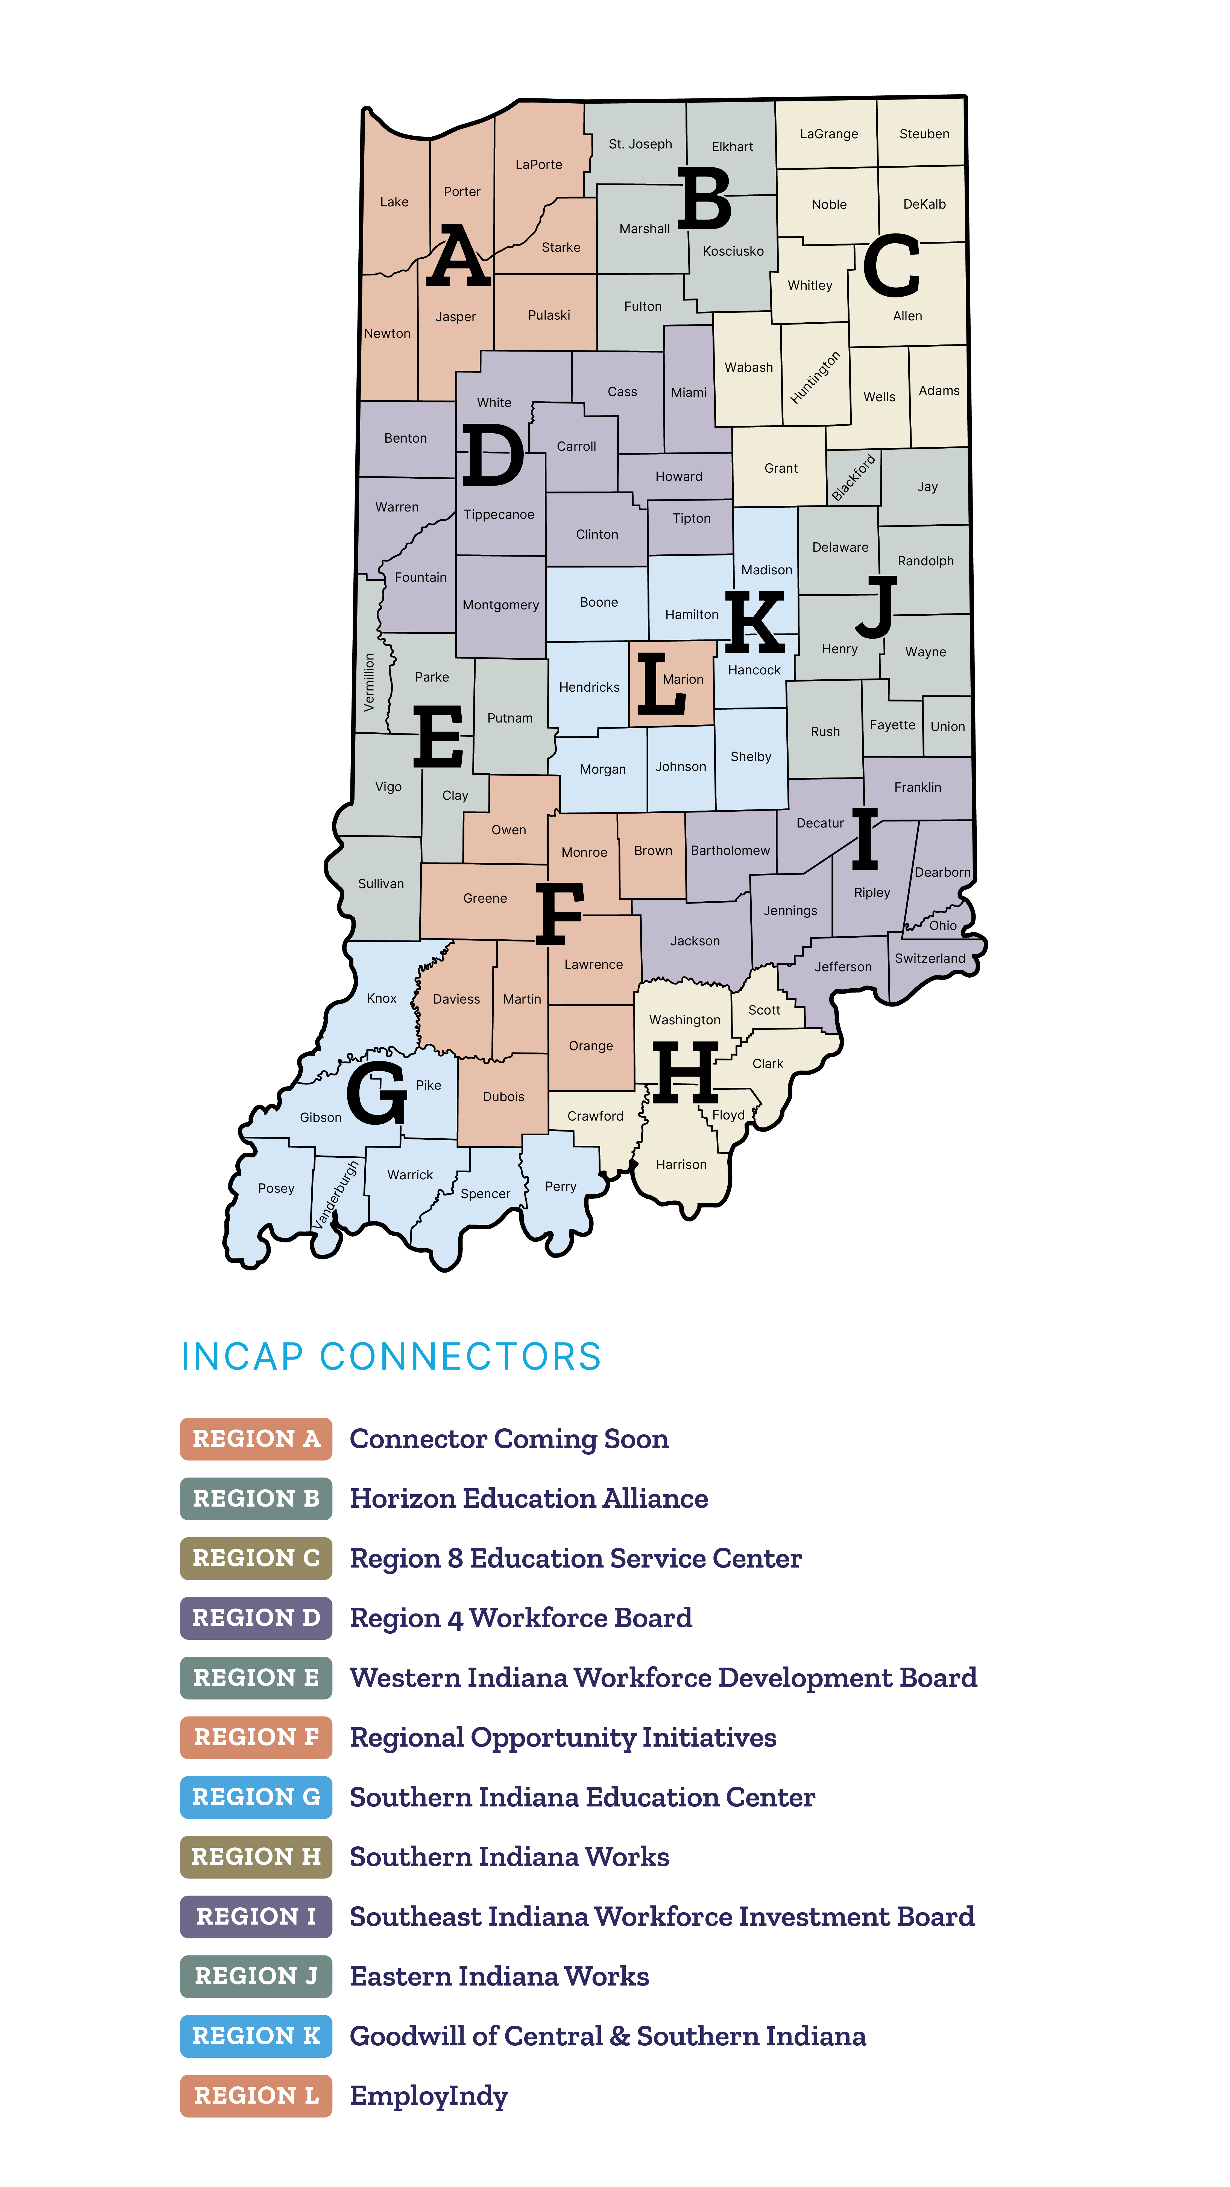
INCAP Connectors Support Schools and Students.
Schools work closely with organizations
called INCAP Connectors, which help link
their students with employers offering apprenticeships in their community.
Our regional INCAP Connector will:
Bring local apprenticeship opportunities
to our school’s students.
Assist students with application process.
Provide support services to our school
and students.
Assist in student schedule coordination.

Slide 5

The Next Step: Explore INCAP Opportunities.
Earning the Employment Honors Diploma Plus Seal along with an INCAP credential or degree prepares students to begin their career, go to college, or transition to the INCAP Career Program.
Interested in learning more about INCAP? Contact your INCAP Connector or School Counselor for more information, including:
How INCAP works for high schoolers.
What INCAP apprenticeships are available.
When to apple for an INCAP apprenticeship.

